Slide 1
TRINITY COLLEGE OF ENGINEERING AND TECHNOLOGY
COMPUTER SCIENCE AND ENGINEERING
Virtual Smart Phone
Presented By
Allepu Anjali
20UD1A0501

Slide 2
Content:
Introduction
Related Work
Argumented Reality
Gesture Recognition
Objective
Working
Technologies Used
Applications
Conclusion

Slide 3

Introduction:
The recent advent of novel sensing and display technologies has encouraged the development of a variety of multi-touch and gesture based interactive systems.
In these systems user may interact directly with information using touch add natural hand gestures.
Unfortunately, most gestural and multi-touch based interactive systems are not mobile and small mobile devices fail to provide the intuitive experience of full-sized gestural systems.
We present VSP-Virtual Smart Phone, a multi-touch and gesture based interaction system.

Slide 4
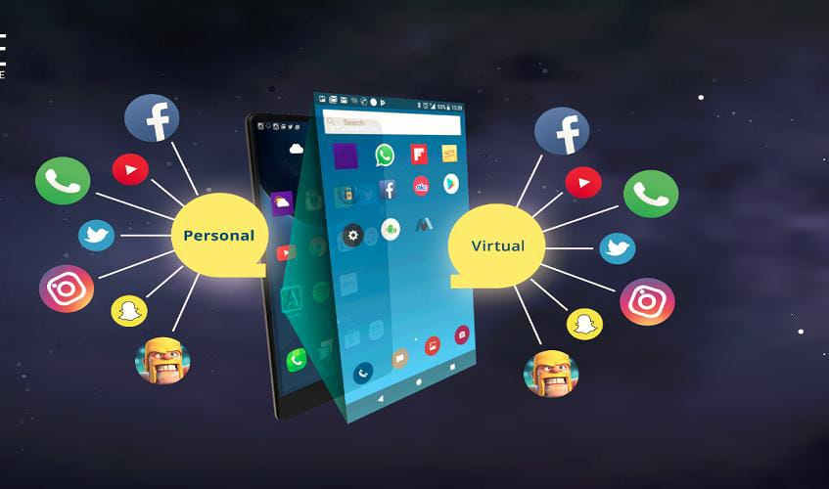

Slide 5
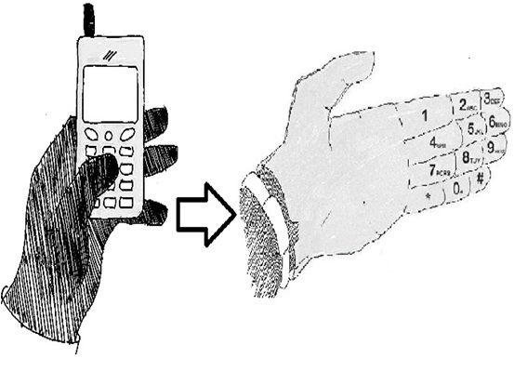
Figure : VIRTUAL SMART PHONE

Slide 6
RELATED WORK:
Recently, there have been a great variety of multi-touch interaction and mobile device products or research prototypes that have made it possible to directly manipulate.
Most of the systems depend on the physical touch-based interaction between the users’s fingers and physical screen and thus do not recognize and incorporate touch independent freehand gestures.
VSP Virtual Smart Phone Technology takes a different approach to computing and tries to make the digital aspect of our lives more intuitive, interactive and, above all, more natural.
We can get instant, relevant visual information projected on any object we pick up or interact with the technology is mainly based augmented reality, gesture recognition, computer vision based algorithm etc.

Slide 7
Argumented Reality:
Augmented reality(AR) is a term for a live direct or indirect view of a physical real world environment whose elements are augmented by virtual computer-generated imagery.
Virtual Smart Phone uses Argumented Reality concept to superimpose digital information on the physical world.
Artificial information about the environment and the objects in it can be stored and retrieved as an information layer on top of the real world view.
The main hardware components for Augmented reality are : display, tracking, input devices, and computer.

Slide 8
Gesture Recognition:
Gestures can originate from any bodily motion or state but commonly originate from the face or hand.
Current focuses in the field include emotion recognition from the face and hand gesture recognition, thus building a richer bridge between machines and humans than primitive text user interfaces or even GUIs(graphical user interfaces).
Gesture recognition enables humans to interface with the machine(HMI) interact naturally without any mechanical devices. Gestures can be used to communicate with a computer so we will be mostly concerned with empty handed semiotic gestures.

Slide 9
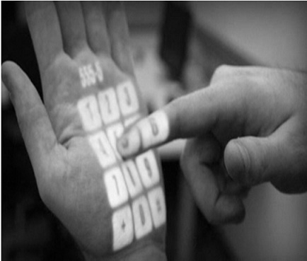

Slide 10
OBJECTIVE:
VSP is basically an attempts to make the communication between users and Digital devices more tangible and interactive.
First, It establish voice communication between the users with the help of GSM Technology without any physical cellular phone.
Second, For Transfer of Data between the humans and also with digital devices.
It make use of the internet through which device and humans are connected to and the distinguish from one user to another by the authentication methods Palm recognition using palm lines or fingerprint detection can be used.
In VSP voice communication form one human to another can be done either by using GSM or Internet/Intranet technology.

Slide 11
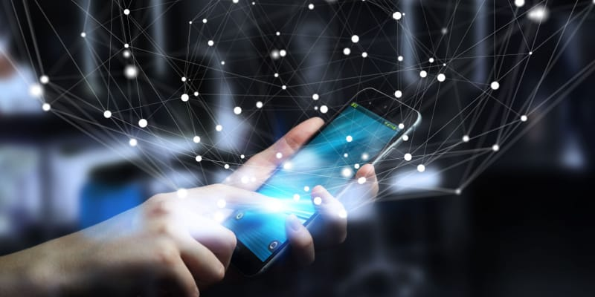

Slide 12
WORKING:
Working of VSP consist of 5 Main steps i.e. Enabling & Authenticate VSP, Make Call, Receive Call, Capture Image/Video, Copying Data & paste/Pass Data to other VSP & Digital Devices as follows.
Enabling VSP
Make Call
Receive Call
Capture Image/Video
Copy Data

Slide 13
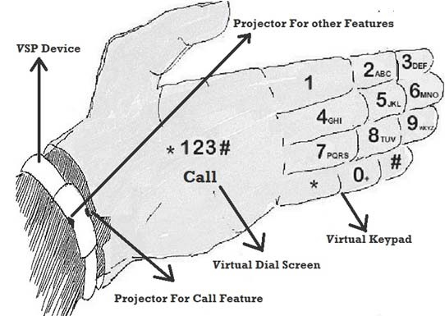

Slide 14
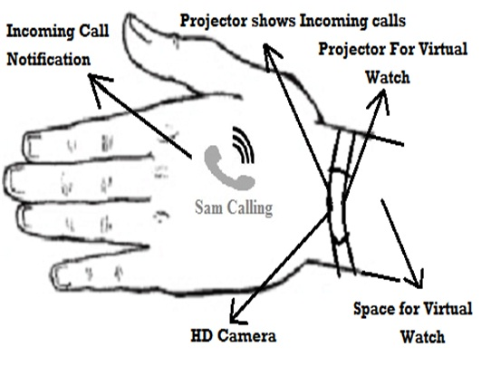

Slide 15
TECHNOLOGIES USED:
VSP is basically a wearable device which is combination of hardware as well as software
Hardware:
Processor Unit
Ram & Rom Memory
Power Supply
Sensors(Accelerometer)
LED Indicator For Device Mode
Micro Vibrator Motor
USB port
4 Micro Projectors
1 HD Camera For Capturing Images and videos
Low energy Required WI-FI and Bluetooth devices ,GPS system

Slide 16
Software:
Gesture recognition system
Touch based interaction system
Augmented reality
Computer vision based algorithm to fulfil all the objectives
VSP uses SIM(GSM/CDMA)or though Internet Using VOIP(voice over Internet Protocol)Technology to Make Call & Receive Call

Slide 17
Applications:
Used In Health Monitoring system.
Used To Find information of any Product/Item.
Used to Connect News and Weather update.
Used To Connect Different Devices Virtually.
Used In Education & Training System.

Slide 18
CONCLUSION:
VSP is basically a computer-vision based wearable and gestural interface that augments the physical world around us with digital information and proposes natural hand gestures as the mechanism to interact with that information. It connect Physical world to Virtual world.
VSP invention fulfill our two future requirements. First, it’s free form physical dependencies of devices. Second, it connect our physical world to virtual world.

Slide 19
REFERENCES:
www.google.com
www.slideshare.com

Slide 20


